Slide 1


The Titanic
Presented by Limo and Suspect

Slide 2
TABLE OF CONTENT
Your Subtitle Here
1
4
TEAM MEMBERS
MISSION
2
5
WELCOME MESSAGE
VISION
3
6
MEET THE CEO
SERVICES

Slide 3
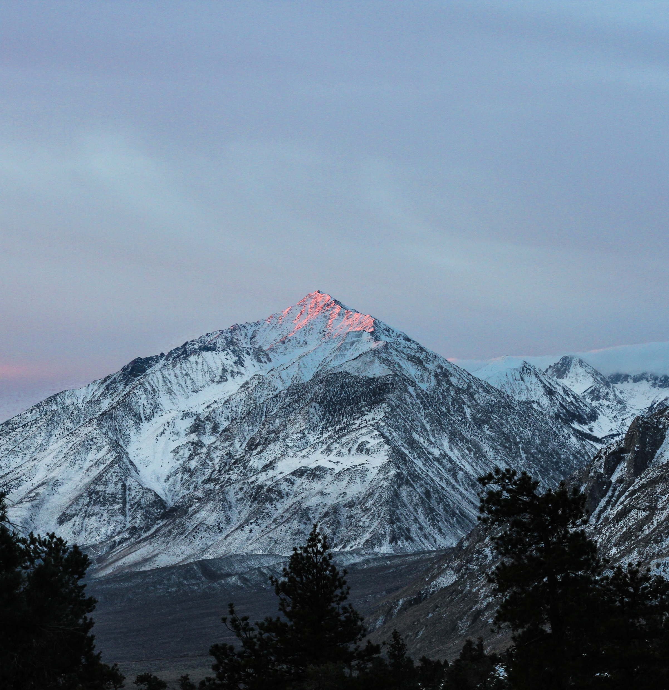
TEAM MEMBERS
AHMET SERHEND YILMAZ
Description here
BAKAR DEMBA DIA
Description here
BARNABY
Description here
GABRIEL KIPKORIR KOSGEY
Description here
LIMO KEMEI
Description here
OWEN KAMAU
Description here

Slide 4
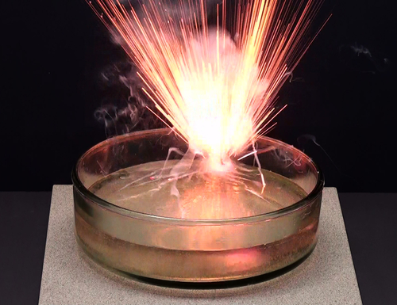
SOLUTION ?
Problem solved

Slide 5

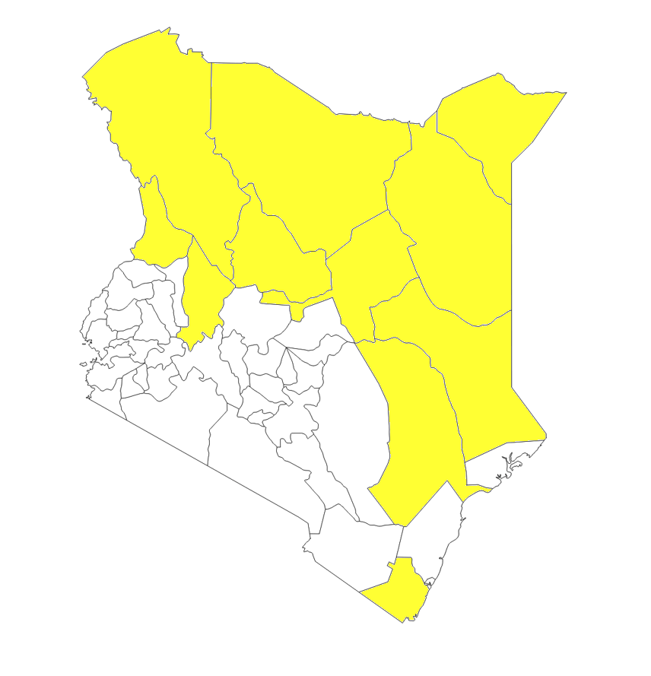





DROUGHT AFFECTED AREAS IN KENYA
Subtitle Here
27 COUNTIES IN KENYA ARE EXPERIENCING SEVERE DROUGHT.
Most of the counties are located in Northern Kenya. This area is very arid and most of it is generally dry. These places are very remote and the natives that live there are struggling to survive with world wide epidemics such as global warming.
More than 2.6 million Kenyans are food insecure and this number is rapidly rising. High levels of malnutrition are prevalent across the arid and semi-arid lands.
These drought conditions that are expected to persist into 2018 have left 3.4 million people severely food insecure and an estimated 500,000 people without access to water. An estimated 482,882 children require treatment for acute malnutrition, including 104,614 who are suffering from severe acute malnutrition. 88% per cent of these children are from 23 arid and semi-arid counties. Drought conditions have led to declines in school attendance and school participation and rising dropout rates.
210k
50k
followers
followers
TWITTER
DROUGHT AFFECTED COUNTIES
Highlighted in yellow

Slide 6
HOW CAN WE SOLVE THIS ISSUE?
Your Subtitle Here
..
YOUR TITLE
aspe
Refers to a good or service being offered
Value
Innovation
Improve
Success
YOUR TITLE
YOUR TITLE
Refers to a good or service being offered
Refers to a good or service being offered

Slide 7




Big shaq
adventures
PROVIDING THE BEST SOLUTIONS

Slide 8
PERCENTAGES
83 %
37 %
50 %
32 %
Percentage of children that
were saved from the ship
Percentage of women that
were saved from the ship
Percentage of men that
were saved from the ship
Percentage of crew that
were saved from the ship

